Slide 1
Nescafe vs Bru
Group -5

Slide 2
Group Members
Nand Parikh 1401023
Prerak Raja 1401041
Varad Bhogayata 1401042
Jay M Joshi 1401052
Parth Shah 1401054
Bhavya Patwa 1401063
Riddhesh Sanghvi 1401074
Karan Patel 1401113

Slide 3
Contents
Swot Analysis of both companies.
Demand theory , Supply theory and Cross Elasticities.
Impact of Various Vendors in Market.
Impact of Advertising.

Slide 4
Abstract
Coffee is a Fast Moving Consumer Good(FMCG).
Coffee is the 2nd most consumed beverage in world.
The consumption of tea is maximum in India, so it has always been difficult for coffee to sustain its growth in market.
Many big companies have entered into the coffee business which has led to increase in demand of coffee.
By taking a case study on Bru vs. Nescafé, we have tried to cover various economic concepts.

Slide 5
Nescafé “It all starts with a Nescafé”
Nestlé's first coffee plant in India was established at Moga(Punjab) in 1961.
Nestle named its coffee Nescafé and the first ever product was Nescafé classics.
Since then it has been a leading brand in coffee.
Many more have joined the competition but the brand has still maintained its top position in the Indian as well as the Global Market.

Slide 6
SWOT Analysis(Nescafé)
SWOT Analysis
Strengths | 1. Strong Nestle brand name
 | 2. Great leap forward in Media through fascinating and excellent marketing campaigns.
 | 3. Good product distribution and availability
 | 4. Lots of flavours and varieties available
 | 5. Sustained improvement in customer service levels.
 | 6. Health conscious products are made keeping in mind the nutritious values.
Weaknesses | 1. Health conscious people avoid coffee as it Contains caffeine
 | 2. Adopted a pricing strategy higher than competitors.
Opportunities | 1. Tie-ups with corporate
 | 2. They can expand their business into the rural areas.
 | 3. They must reduce their price according to the places they are selling their products.
Threats | 1. Health conscious people avoiding coffee
 | 2. Budget conscious consumers switch to supermarket house brands.
 | 3. Instant coffee perceived as boring.

Slide 7
Bru “Happiness begins with Bru”
Bru is the coffee brand from the HUL and was launched in 1969.
Varieties of coffee: Bru frothy coffee, Bru iced frappe, Bru instant coffee and Bru Malabar roast and ground coffee.
The roasted and ground coffee is mostly consumed in southern India hence Bru has a big market over there.

Slide 8
SWOT Analysis(Bru)
SWOT Analysis
Strengths | 1. Lower prices offered of the product than Nescafé.
 | 2. Strong distribution channel being a product of HUL.
 | 3. Bru is a leader of filter coffee.
Weaknesses | 1. Coffee as a category still nascent in many countries like India
 | 2. Despite of capturing 26% market share of Nescafé in R&G coffee sector, Bru is still the no. 2.
 | 3. Coffee outlets and vending machines are missing from the market unlike Nescafé.
 | 4. Less number of variety of products.
Opportunities | 1. Cheaper packets for rural areas
 | 2. The market for roasted and ground coffee has great potential for Bru.
 | 3. Now HLL is HUL hence Bru can expand globally.
Threats | 1. In this competitive era Bru reduced its prices to an extent which might reduce its profit as well.

Slide 9
Impact Of Various Vendors in Market
Farak Padta Hai….

Slide 10
Retailer vs Mall vs. Online
For any company a concerning issue is to supply goods to all type of consumers.
As different type of customers prefer buying product from different type of seller i.e. a person with easy access to technology will prefer to buy goods from online market or vice-versa.
Here we wish to present various policies a company adapt to sell maximum goods to all 3 type of major vendors i.e. Malls , Retailers and Online market.
For studying we visited rural and urban provision stores, Coffee stalls and urban supermarkets.

Slide 11
Urban Retailers
We visited various provision stores. From that what we could conclude about the current scenario is listed as follows:
The package which was sold maximum was Nescafe in comparison to Bru .The selling ratio was 8:2(Nescafe:Bru).
The price of 50 gm was approx. Rs. 120 and the reatilers would make a profit between Rs. 2 to Rs. 5.
Stock sold was approx. 2 dozen per week.

Slide 12
Rural Retailers
In Sarkhej area only 1 provision store out of the 7 stores we visited, had Bru coffee.
Here price was an important factor and hence coffee sales was very low. They usually sell Nescafe Sunrise sachets and in loose packing. Along with that they even sold coffee of a local producer.

Slide 13
Urban Supermarket
We visited D-mart of satellite area.
Nescafe was sold more as compared to Bru. Also Nescafe(50 gm) packing was sold maximum.
Here the ratio is 65:35(Nescafe:Bru)
As D-mart buys the product in bulk they have a large scope of giving offers and they exploit this to increase their sale.

Slide 14
Urban Supermarket
D-mart Sales Representative informed us that apart from their own offers Nescafe very often gives offers like Jars or biscuit packets or some other goods free with Nescafe Classic. This could be stated as giving consumer surplus in economic terms, i.e., giving the customer more goods at relatively lower rates. Hence they are able to purchase a product for a price that is less than the highest price that they would be willing to pay.
During such offer periods there has been a rise of approximately 25% sales in Nescafe classic in D-mart.

Slide 15
Online Stores
Grofers and BigBasket are yet growing online markets and have not affected the sales of the supermarkets very much.
The tie up of grofers with provision stores in fact has a great potential of increasing the sales of coffee in retail stores with offers.
Krishna general stores which is affiliated with grofers stated that the sales of Nescafe has been good after grofers because of recurring offers coming up in Nescafe compared to Bru.

Slide 16
Demand , Supply & Cross Elasticity
Nescafe Vs Bru
Brook Bond Red Label

Slide 17
Data Analysis
We got the data for total demand and supply and of coffee in India, this representative data is then adjusted according to the market stakes of respective brand for the particular year.
Also for studying Demand and Supply , if prices have been changed more than once in a particular year then the average price for that particular year has been taken into consideration.
Similarly for Cross elasticity Brook Bond Red label tea has been taken in consideration and demands of Nescafe and Bru has been studied individually.

Slide 18
Demand Theory.
According to this theory as price of a particular commodity decreases its demand increases, here the behaviour of consumer must be rational.
Thus Demand curve will be a graph representing the variation in demand whenever there is a variation in price.
Our Analysis
The data ,we collected at some point contradicts the theory, main reason for this is change in taste nowadays, increase in ones income over the span of time, more exposure and advertising which influences consumers, strong establishment of brand name etc.

Slide 19
Data For Demand Theory
Data Table:
Market Stakes:
YEAR | Price Per Kg(Nescafe) | Price Per Kg(Bru) | Demand in Tonnes (Nescafe) | Demand in Tonnes (Bru)
2010 | 1580 | 1175 | 44290 | 38110
2011 | 1600 | 1190 | 47700 | 46640
2012 | 1843.8 | 1350 | 32340 | 26400
2013 | 2109 | 1390 | 39600 | 25920
2014 | 2140 | 1473 | 75000 | 37500
2015 | 2200 | 1495 | 83490 | 31625
Market Stakes(%)
Bru | Nescafe
41% | 43%
49% | 47%
40% | 52%
36% | 55%
30% | 60%
25% | 66%

Slide 20
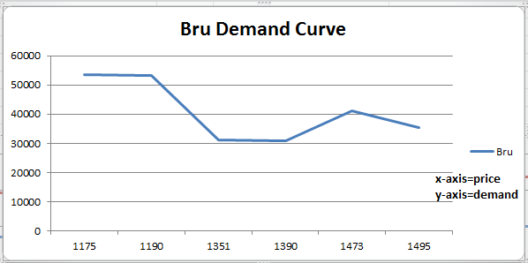
Curves For Demand Theory

Slide 21
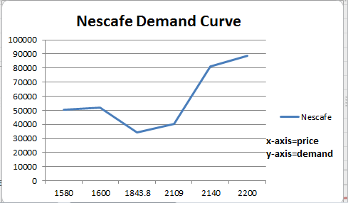
Nescafe(Classic) Demand Curve

Slide 22
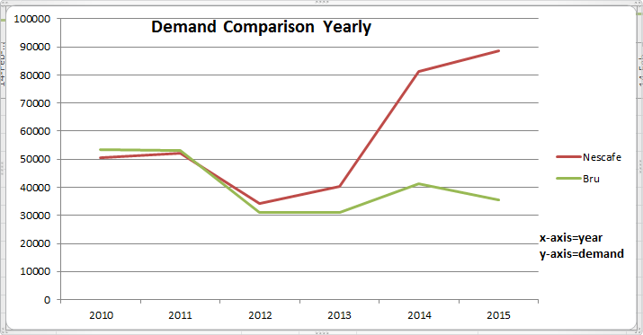
Comparison Between Nescafe and Bru

Slide 23
Results
The above results have been acquired for Nescafe Sunrise and Bru Lite.
From the given curves the following results are derived.
Till 2012 (2008-2012) Bru and Nescafe acquired an equal share.
But after 2013 Nescafe’s demand saw new peaks.
According to Economic Times Bru which was once covering 50% market, crashed to merely 27% where as Nescafe has emerged as pure winner by capturing above 65% of market stake.

Slide 24
Supply Theory
Rational behaviour of producer is to supply more goods as price increases, but sometimes there are variation , because due to abrupt change (increase) in price a typical consumer buys less goods.
Thus Supply curve will be a graph representing the variation in Supply whenever there is a variation in price.
Data Analysis
As Both companies are exporting their product to other countries supply is extremely huge compared to demand, in our data.

Slide 25
Data For Supply Theory
Data Table:
Year | Price Per Kg(Nescafe) | Price Per Kg(Bru) | Supply in Tonnes (Nescafe) | Supply in Tonnes (Bru)
2010 | 1580 | 1175 | 78905 | 75235
2011 | 1600 | 1190 | 95504 | 89408
2012 | 1843.8 | 1350 | 118243 | 84778
2013 | 2109 | 1390 | 129840 | 69248
2014 | 2140 | 1473 | 144064 | 63028
2015 | 2200 | 1495 | 168910 | 50673

Slide 26
Supply Curve For Nescafe

Slide 27
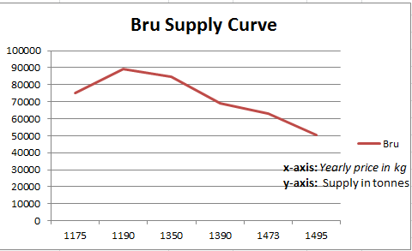
Supply Curve For Bru

Slide 28
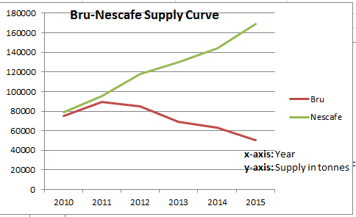
Comparison between Nescafe and Bru

Slide 29
Results
Results of Nescafe for supply curve provide promising results, their supply has increased as their price has increased.
Contradictory, the supply of Bru has decreased because according to data table of market stakes, Bru’s market hold has also decreased from 49% to mere 25% , as their production cost increases they need to increase their price but as their demand has decreased they will surely produce(supply) less goods.

Slide 30
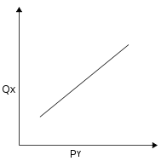
Cross Elasticity
By definition of cross elasticity:
Two goods that are substitutes have a positive cross elasticity of demand, as the price of good Y rises, the demand for good X rises.
Tea and coffee are substitutes of each other , so as price of tea increases then demand of coffee increases and vice versa.
An ideal graph for the same is shown below.
Qx = Quantity demand for coffee1.
PY = Price of coffee2/Tea.

Slide 31
Analysis and Mathematical Model
We have calculated cross elasticity between price of Brooke Bond and demand of Nescafe and Bru, cross elasticity between price of Nescafe and demand of Bru and cross elasticity between price of Bru and demand of Nescafe.
Let Ed be the cross elasticity constant
y = %increase in demand of Coffee
x = %increase in price of Tea
Then:
Ed = %increase in demand of Coffee/%increase in price of Tea.
Ed = y/x;
Hence
Y = Ed*x.

Slide 32
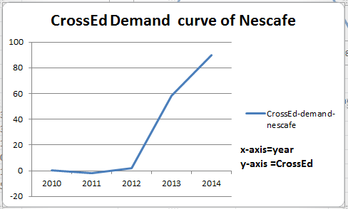
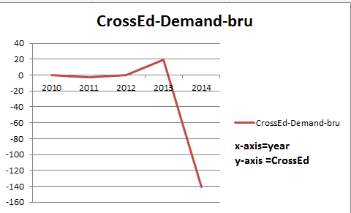
Graph Of Cross Elasticity
Cross Ed of Nescafe vs. Tea
Ed: %inc in Nescafe Demand/ %inc in Price of tea
Cross Ed of Bru vs. Tea
Ed: %inc in Bru Demand/ %inc in Price of tea

Slide 33
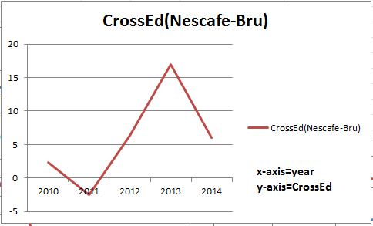
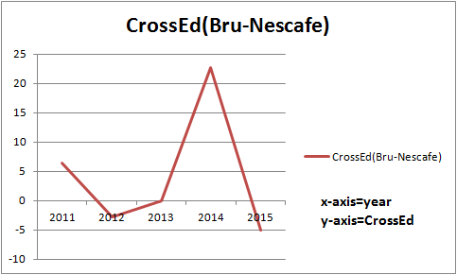
Graph Of Cross Elasticity
Cross Ed of Nescafe vs. Bru
Ed: %inc in Nescafe Demand/ %inc in Price of Bru
Cross Ed of Bru vs.Nescafe
Ed: %inc in Bru Demand/ %inc in Price of Nescafe

Slide 34
Impact Of Advertising
Jo Dikhega Wo Bikega……

Slide 35
Advertising Strategies
Pushing Consumers for more Usage
Stepping up, Front End Execution
Appealing Rural Market.
Leveraging Information Technology and Social Media.
Betting on Big Stars for Advertising.
Bigger Better and Faster Innovation.

Slide 36
Pushing Consumers for more Usage
Both companies push their consumers for buying more and more of their product, for this both companies have came up with concrete ideas like:
Low Cost Sachets: A typical consumer may not buy a bigger packing once, but will buy small packing frequently.
Seasonal Products: Both companies try to attract consumers by keeping varieties of product like Bru Gold for Winter, Nescafe Choca - Mocca for Summer etc.
Nescafe and Bru have been equally successful in encouraging customers for trying their various products and have appealed every class of society.
But when it comes to low cost sachets Nescafe took care of urban areas with sachets and of rural areas with loose packing which in turn reduced its cost substantially and it got a strong hold in rural areas.

Slide 37
Stepping up Front end Execution
More Stores: Both companies have tried to reach maximum possible retail units or Super markets as they want to cover maximum range of consumers.
Both companies tried to establish their own stores to provide better services.
Nestle outraced HUL by establishing stores and outlets solely for advertising and selling its product. HUL could not attain this level of networking in its own outlets.

Slide 38
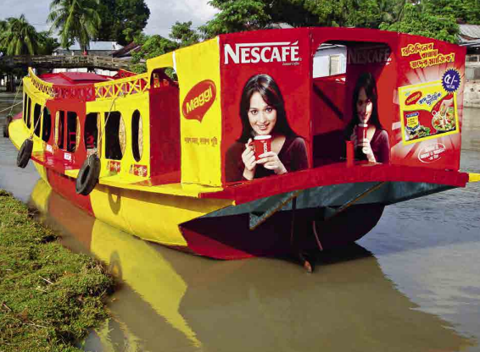

Appealing Rural Market
In India Rural public consists of a whooping 68%. Hence it is really crucial for the companies to increase there strong hold on this chunk.
Nescafe: As a company totally focused on food Products, marketing its various product through nutritional camps and awareness drives Nestle has successfully passed its product to rural places.
Bru(HUL): Being a multinational giant with various product HUL has failed to create impact of its edible product and beverages in rural part.
According to a report of economics time(2011) Nescafe acquires 65-70% of rural market where as Bru as only acquired 7-10%.

Slide 39
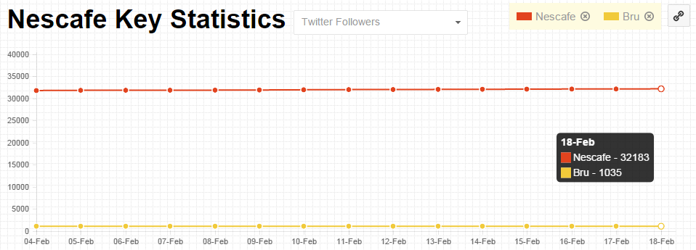
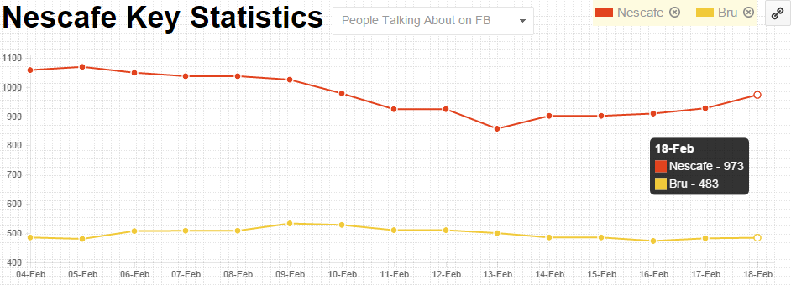
Leveraging Information Technology and Social Media

Slide 40
Betting on Bigger Stars
In the competition to sell more, both companies have always tried to approach and cast bigger stars in their advertisements.
Nestlé's Star line includes Deepika Padukone , Shankar-Ehsan-Loy , and some of the regional stars for particular zone e.g. Surya is their ambassador for Southern India.
On the other hand HUL due to bigger brand value has managed to include the most popular pair of any given time like Shahid-Priyanka, Anushka-Siddharth etc.
Such humongous star cast is one of the prime reason that BRU has been able to compete with Nescafe over the period of time.

Slide 41
Conclusion
By looking at various factors, various theories of economics we have presented a complete analysis of 2 leading brands in a FMCG goods and we can see that Nescafe is a clear winner for now.

Slide 42
References
Cross Elasticity: https://en.wikipedia.org/wiki/Cross_elasticity_of_demand
Data of Prices from 2010 to 2015 of Nescafe and Bru: http://web.archive.org/web/*/bigbasket.com
Nestle Annual Reports: http://www.nestle.com/investors/publications
Social Analytics: http://brandequity.economictimes.indiatimes.com/social-analytics

